Slide 1
Exploratory Data Analysis (EDA) for Real Estate Pricing
By Shubham Saxena
Affiliation: DigiCrome

Slide 2
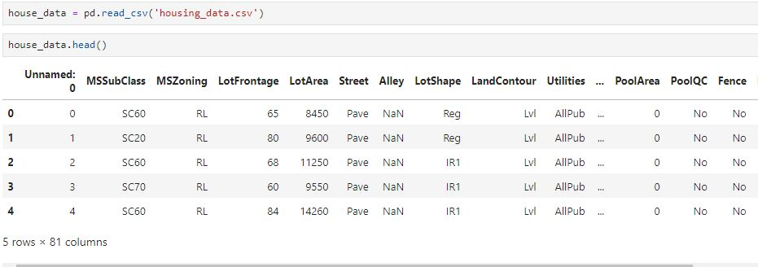
Project Overview :-
Exploratory Data Analysis (EDA) for Real Estate Pricing: Unveiling the Dynamics of House Valuation in a Dynamic Market
Here I have done data wrangling, central tendency of the data, filling missing values,, detection of Outliers and it’s removal, along with their correlation of the data for better price of property

Slide 3
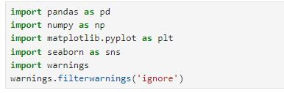
Project Highlights :- Important libraries which are used :-
import pandas as pd
import numpy as np
import matplotlib.pyplot as plt
import seaborn as sns
Import warnings (to ignore unwanted warnings)
Pandas
Numpy.
Matplotlib
seaborn
Warnings

Slide 4
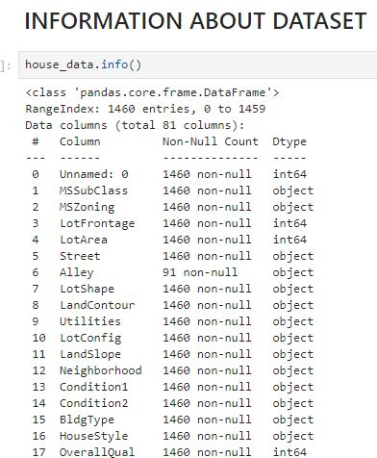
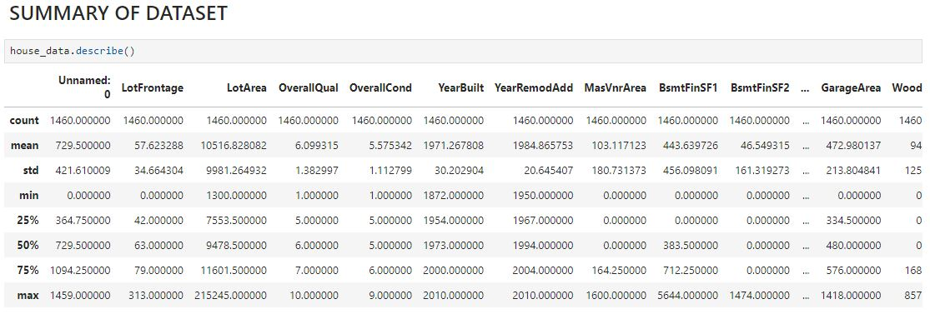
Problem Statement:- here we are doing some functions to understand housing_data

Slide 5
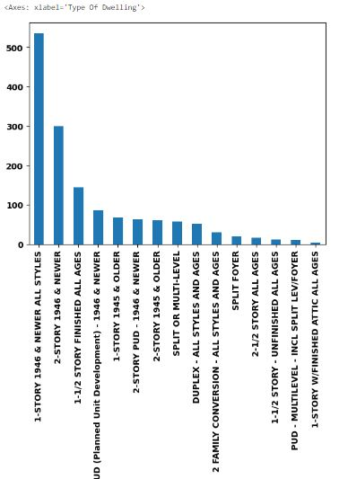
Barplots of different correlation of data:-

Slide 6
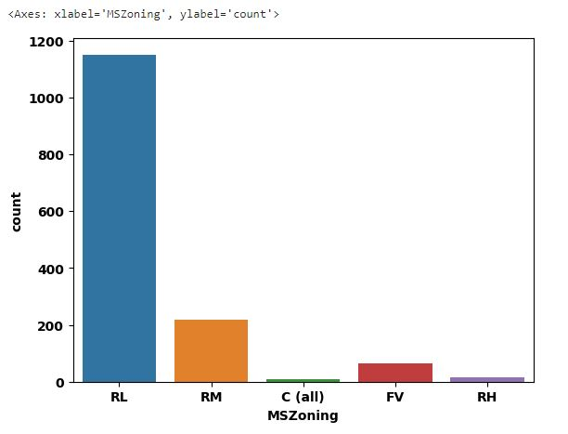
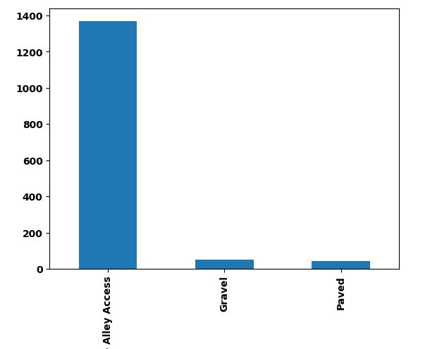
Barplots of different correlation of data:-

Slide 7
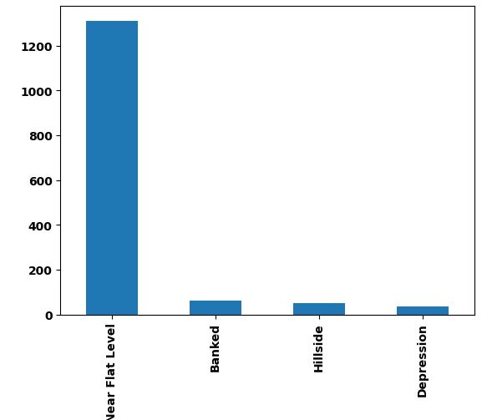
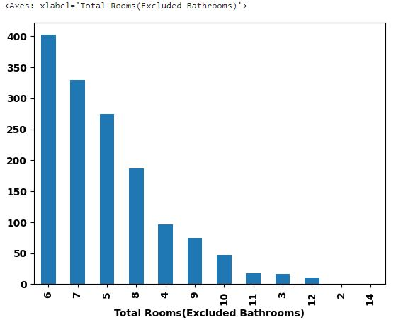
Barplots of different correlation of data:-

Slide 8
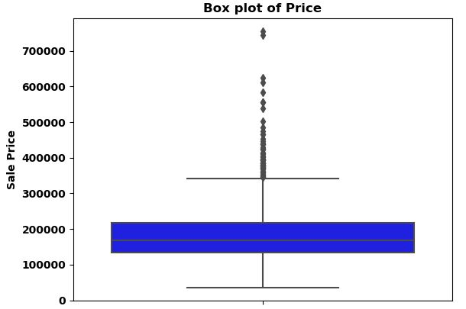
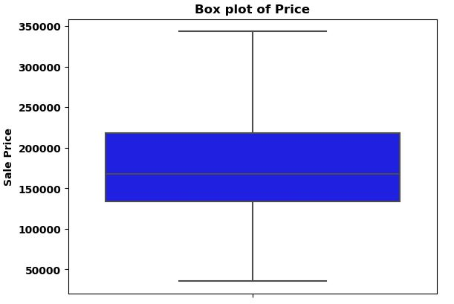
Methodology:- Used related modules to identify Outliers in final data and removed it.

Slide 9
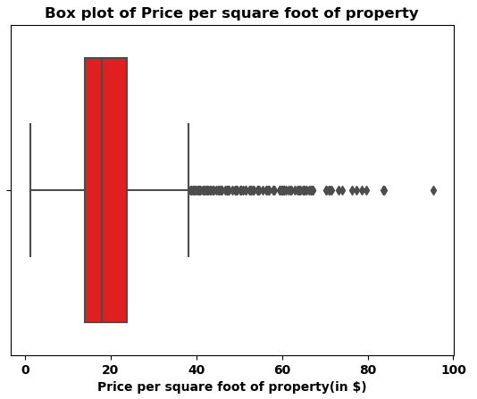
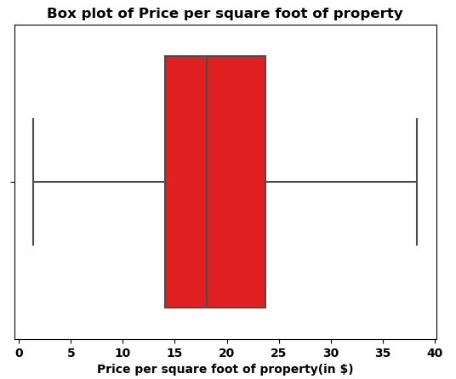
Methodology:- Used related modules to identify Outliers in final data and removed it.

Slide 10
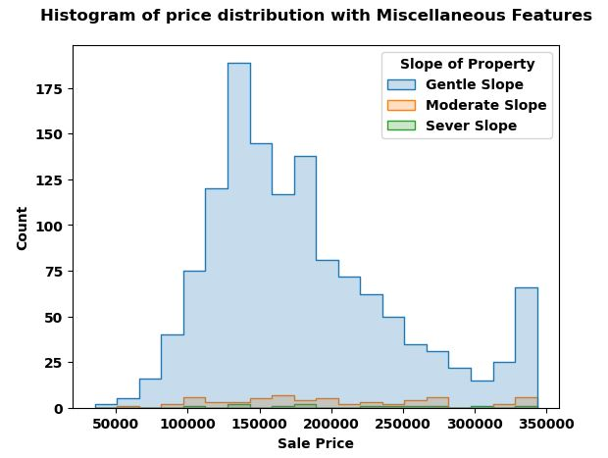

Slide 11
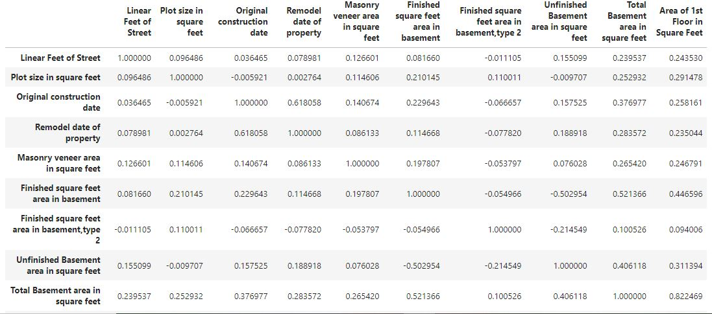
Glimpse of Final data :- Correlation of Final data with each others.

Slide 12
Conclusion:-
The prices of properties are higher for:
House having new age of property, means house construct and sold within 20 years of construction have better and high prices
House having total 7-10 rooms, 1 kitchen, 1-2 Full Bathrooms and shape of property Regular/Slightly Irregular
House having total living area between 1500-2500 sqr ft, size of garage 500-800 sqr ft.
Having Garage attached to home, 2-3 car parking capacity, Average quality and condition of garage

Slide 13


